Slide 1
Cost Sheet Problems

Slide 2
Other interest and financing charges for production of goods / operations or service rendered (CAS -17) (Only Net)
Interest on Bank Loan
Cash Discount allowed on sales (to customers)

Slide 3
Total Cost
Direct Cost Indirect Cost
Direct Materials Indirect Materials
Direct Expenses Indirect Expenses
Direct Wages Indirect Wages
Raw Materials – First Head
Forms of Material W-I-P -- Second Head (Factory Over Head)
Finished Goods – Third Head (Office Over Head)

Slide 4
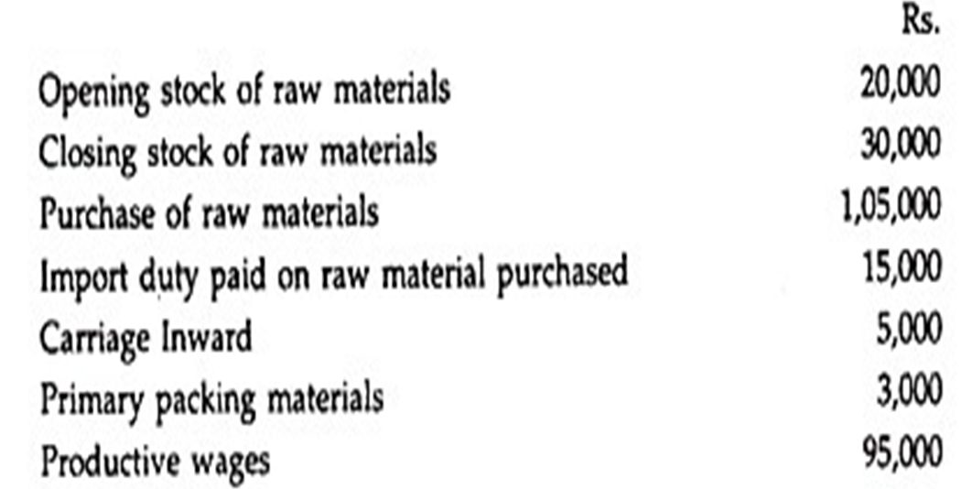
1. From the following particulars of a manufacturing concern, ascertain the Prime Cost

Slide 5
Statement Showing Prime Cost
Particulars Amount Total
Opening Stock of Raw Materials 20,000
Add: Purchase of raw materials 1,05,000
Import Duty 15,000
Carriage Inward 5,000
Primary packing Materials 3,000 1,28,000
1,48,000
Less : Closing Stock of Raw Materials 30,000
Raw Materials Consumed 1,18,000
Add : Productive Wages/ Direct Wages 95,000
Add: Direct Expenses
Hire Charges on plant 14,000
Other chargeable expenses 6,000 20,000
Prime Cost 2,33,000

Slide 6
2. Calculate Prime cost from the information given below.
Purchase of raw materials- Rs. 50,000.
Opening stock of raw materials- Rs.4,000.
Closing stock of raw materials- Rs. 3000.
Direct Wages- Rs. 16,000.
Carriage/Freight inwards- Rs.2,000.
Carriage outwards - Rs. 3,500.
Direct expenses- Rs. 4,500.
Indirect expenses- Rs.6,700.
Duty on Purchase- Rs.250
Materials returned to suppliers (P/R)- Rs. 100
Material Sold- Rs. 250
Material Transferred to firm- Rs. 200
Scrap Sold Materials- Rs. 100
Loss by Fire Materials- Rs. 800
Calculation of Prime Cost.

Slide 7
Statement Showing Prime Cost
Particulars Amount Total
Opening Stock of Raw Materials 4,000
Add: Purchase of raw materials 50,000
Carriage Inward 2,000
Duty on Purchase 250 56,250
Less : Material returned to suppliers (P/R) 100
Material Sold 250
Material Transferred to Firm 200
Scrap Sold Materials 100
Loss by Fire Materials 800
Closing Stock of Raw Materials 3,000 4,450
Raw Materials Consumed 51,800
Add : Productive Wages/ Direct Wages 16,000
Add: Direct Expenses 4,500
Prime Cost 72,300

Slide 8
3. From the following information for the month of January prepare cost sheet to show following components. a) Prime cost. b) Factory cost. C) Cost of production. D) Total cost.
Direct material- Rs. 57,000 Direct wages- Rs. 28,500 Direct expenses – Rs. 10,000 Factory rent & rates- Rs. 4,500 Indirect wages Rs. 5,000 Plant repairs & maintenance Rs.1,000 Plant depreciation- Rs. 1,250 Factory heating & lighting- Rs. 400 Factory manager’s salary- Rs.2,000 Motive Charges- Rs. 4,600 Haulage- Rs. 3,500 Director Fees(Work/Factory)-Rs.1,500 Electricity Charges- Rs. 1,500 Fuel, Gas lubricants Etc- Rs. 1,000 Work Stationary- Rs 500 ESI-Rs. 600 Indirect Expenses- Rs. 700 Depreciation On Furniture Rs. 2,400 Water Supply_Rs. 1000 Loose Tools Written Off-Rs. 500 Estimating Expenses- Rs. 700 | Drawing Office Salary- Rs 800 Office rent & rates- Rs. 500 Office Insurance- Rs. 700 Sundry office Expenses-Rs. 600 Office Salary- Rs.1,600 Director’s remuneration(office)Rs.1,500 Telephone & postage- Rs. 200 Printing & stationery- Rs.100 Legal charges- Rs. 150 Counting House Salary-Rs. 900 Audit fees- Rs. 800 Bank Charges-Rs. 700 Advertisement- Rs. 1,500 Salesmen’s salary- Rs. 2,500 Showroom rent- Rs. 500 Rent of Ware house- Rs. 500 Commission on Sales – Rs. 1,920 Upkeep of Delivery Van-Rs. 600 Bad Debts- Rs. 200 Depreciation of Delivery Van-Rs.400 Sales- Rs. 1,40,000

Slide 9
Statement Of Cost Sheet
Particulars Amount Total
Direct Materials 57,000
Direct Wages 28,500
Direct Expenses 10,000
Prime Cost 95,500

Slide 10
Add: Factory Overhead
Factory rent & rates 4,500
Indirect wages 5,000
Plant repairs & maintenance 1,000
Plant depreciation 1,250
Factory heating & lighting 400
Factory manager’s salary 2,000
Motive Charges 4,600
Haulage 3,500
Director Fees (Work/Factory) 1,500
Electricity Charges 1,500
Fuel, Gas ,Lubricants Etc 1,000
Indirect Expenses 700
Depreciation On Furniture 2,400
Water Supply 1000
Loose Tools Written Off 500
Estimating Expenses 700
Drawing Office Salary 800
Work Stationary 500
ESI 600 33,450
Works/ Factory Cost 1,28,950

Slide 11
Add: Office & Administration overheads
Office Salary 1,600
Director’s remuneration(Office) 1,500
Telephone & postage 200
Printing & stationery 100
Legal charges 150
Office rent & rates 500
Office Insurance 700
Sundry office Expenses 600
Counting House Salary 900
Audit fees 800
Bank Charges 700 7,750
Cost of Production 1,36,700

Slide 12
Add: Selling Overheads
Advertisement 1,500
Salesmen’s salary 2,500
Showroom rent 500
Rent of Ware house 500
Commission on Sales 1,920
Upkeep of Delivery Van 600
Bad Debts 200
Depreciation of Delivery Van 400 8,120
COST Of Sales/Total Cost 1,36,700
Profit (1,40,00-1,36,700 ) 40,820
Sale 1,40,000

Slide 13
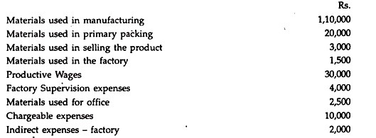
4. The following particulars have been obtained from the cost records for the Year Assume that all products manufactured during the year have been sold to earn a profit of 20% on selling price

Slide 14
Statement Of Cost Sheet
Particulars Amount Total
Direct Materials 1,10,000
Direct Materials used 20,000
Freight on materials purchased 5,000
1,35,0000
Direct Labour
Productive wages 30,000
Chargeable expenses 10,000
Prime Cost 1,75,000
Add: Factory Overhead
Materials used in factory 1,500
Factory supervision expenses 4,000
Factory Indirect expenses 2,000
Depreciation on factory building 3,500 11,000
Works/ Factory Cost 1,86,000

Slide 15
Add: Office & Administration overheads
Materials used in office 2,500
Administration Expenses 3,000
Depreciation on Office building 1,500 7,000
Cost of Production 1,93,000
Add: Selling Overheads
Materials used in selling the product 3,000
Advertisement 2,000
Bad Debt 1,500 6,500
1,99,500
Add: Distribution Overheads
Depreciation on Delivery Van 1,000
Salary to driver of delivery van 3,600 4,600
COST Of Sales/Total Cost 2,04,100
Profit @20% on cost 40,820
Sale 2,44,920

Slide 17
5.From the following information prepare a cost sheet. Company Desire a Maergi of 20% profit on the cost of sales

Slide 18
Statement of Cost Sheet
Particulars Amount Total
Direct Materials-Purchased 80,000
Add : Opening Stock of Raw Materials 20,000
1,00,000
Less : Closing Stock of Raw Materials 25,000
Materials Consume 75,000
Direct Wages 22,000
Direct Expenses 5,000 Prime Cost 1,02,000
Add: Works OR Factory Overheads
Consumable stores 4,000
Factory manager salary 15,000
Unproductive wages 7,000
12,000
38,000
Add : Opening Stock of WIP 13,000
Less : Closing Stock of WIP 7,000 44,000
Factory / Works Cost 1,46,000

Slide 19
Factory / Works Cost 1,46,000 (Previous Page Balance)
Add : Administration/Office overhead 28,000
Cost of Production 1,74,000
Add : Opening Stock of Finished Goods 5,000
1,79,000
Less : Closing Stock of Finished Goods 10,000
Cost of goods Sold 1,69,000
Add :Selling and Distribution Overhead 33,000 Cost of Sales/Total Cost 2,02,000
Add : Profit @ 20% on cost of sales
( 2,020,000 X 20%) 40,400
Sales 242,400

